Slide 1
Object Oriented Programming Lecture - 26
Prof. Varsha Dange

Slide 2
Marker Interface
The marker interface in Java interfaces with no field or methods
empty interface in java is called a marker interface.
Example of marker interface is Serializable, Cloneable, and Remote interface.
it indicates a signal or command to the JVM.

Slide 3
Cloneable interface
Cleanable interface in Java is also a marker interface that belong to java.lang package.
It generates replica (copy) of an object with different name.
We can implement the interface in the class of which class object to be cloned. It indicates the clone() method of the Object class.
If we do not implement the Cloneable interface in the class and invokes the clone() method, it throws the ClassNotSupportedException.

Slide 4
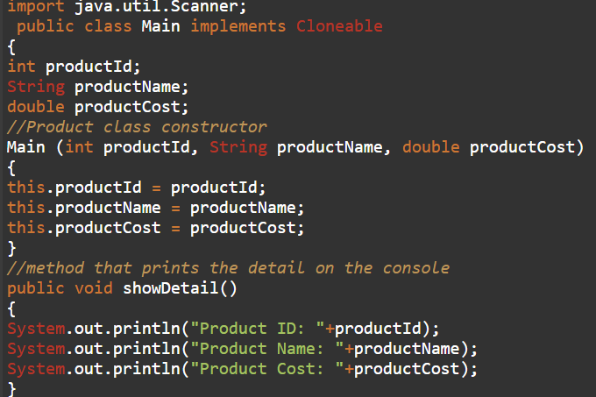
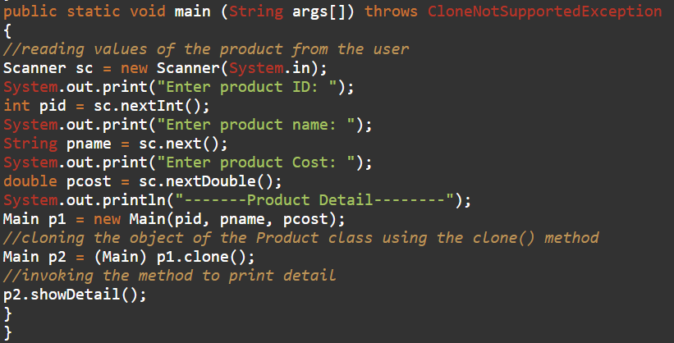
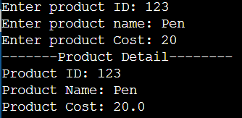
Cloneable interface

Slide 5
Serializable interface
It is a marker interface in Java that is defined in the java.io package.
If we want to make the class serializable, we must implement the Serializable interface.
If a class implements the Serializable interface, we can serialize or deserialize the state of an object of that class.
Serialization (converting an object into byte stream) is a mechanism in which object state is read from the memory and written into a file or database.
Deserialization (converting byte stream into an object) is the opposite of serialization means that object state reading from a file or database and written back into memory is called deserialization of object.
Serialization (writing) can be achieved with the ObjectOutputStream class and deserialization (reading) can be achieved with the ObjectInputStream class.

Slide 6
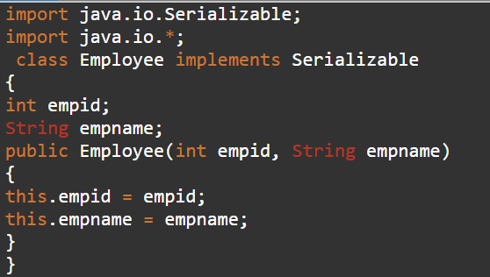
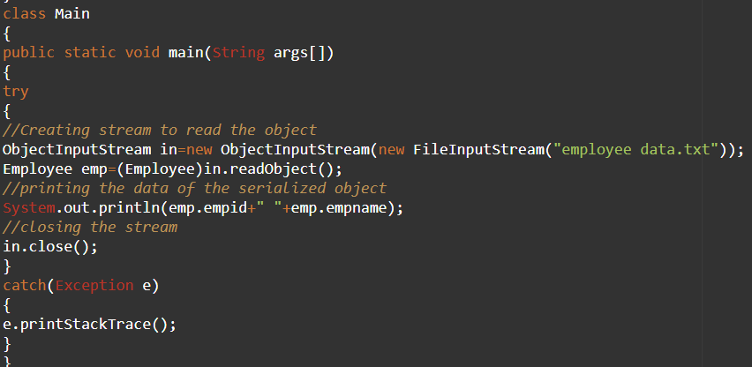
Serializable interface

Slide 7
Remote interface
Remote interface is a marker interface that belong to java.rmi package.
It marks an object as remote that can be accessed from another machine (host).
must implement the Remote interface if we want to make an object as remote.
It identifies the interfaces whose methods can be invoked from a non-local JVM.
Any remote object must implement the interface directly or indirectly.

